Slide 1





Froogal: Development Update 1
By Chris Adamson, Dylan Commean, & Johnathan Dickson
Notes:
Speaker - Johnny
# Notes
Attention Grabber: “If money wasn’t a thing, how would you spend your time?”

Slide 2
Today’s Agenda
Reminiscing Initial Proposal
Revised Requirements
Revamped App Design
Development Milestones
Current Development
Next Phase in Development
Potential Issues
Notes:
Speaker - Johnny
Transition: “I’ll now hand it over to Chris to discuss our initial proposal and changes since then”

Slide 3
Reminiscing:
Second glance of initial proposal
Notes:
Speaker - Chris

Slide 4
Reminiscing: App’s Initial Proposal
Froogal is…
Beginning Hurdles
Tailwind CSS vs. Chakra UI
SQL vs. Firebase
How to structure user data
How to transfer user data (JSON or ?)
A financial web app geared to monitor & tracking user spending habits.
Notes:
Speaker - Chris
# Notes
Deciding between certain tech stacks was a hurdle in the beginning.
Tailwind:
Utility first CSS framework
Have to make own components
Easier styling & more customization
Chakra:
Less styling options & customization
Component based library; reduces work in making your own components
SQL:
Relational data storage
Not all stored as a big JSON file
Firestore:
NOSQL like database
Store individual users as documents in a collection
JSON formatted

Slide 5
Revisions:
Updating the project
requirements
Notes:
Speaker - Chris

Slide 6
Revisions: Notable Updates
UI, in terms of rendering data, has been consistent
Created initial ERD and other documentation
Chose Firestore over SQL
Chose JSON for data transfer
Chose Chakra UI over Tailwind
Notes:
Speaker - Chris
# Notes
Requirements have been constantly evolving as development progresses.
Project has been relatively straight-forward. Not many revision in terms of tech stack, but mostly revision in what data to store from user & how to store that data
Chakra for component reusability & design
Most Notable Updates:
Decided on what user data to get
Decided on how to store user data (JSON)
Decided on Firestore as a database
Created UI Skeleton

Slide 7
Revamps:
Restructuring Froogal
Notes:
Speaker - Chris
# Notes
Introduce the idea of how during the development we have rethought some of the structures and have decided to make some minor adjustments to make the better overall

Slide 8
Revamps: Navbar Switchup
Original
Revamped
Sidebar layout
No routing to separate pages (uses Drawers now)
See Appendix for updated routing
Single top bar w/ links to finance settings & user settings pages
Notes:
Speaker - Chris
# Notes
Navbar:
Redesigned to be a sidebar
Sidebar:
contains links to settings drawers
removes need for two extra routes (/finance-settings & /user-settings)
Handles user logout
Advantages of removing routes:
Less requests to server (b/c not asking for pages)
State is within the dashboard & not between diff pages
More interactive UI, increasing user interest
Over/Under Signaler
Added quotes generator to the component

Slide 9
Revamps: Modals & Drawers
Original
Revamped
Modals now reusable for many dependent components (Drawers & watchers)
Modals were more specific to components
No Drawers for settings
Notes:
Speaker - Chris
Transition: “I’ll now hand it over to Dylan to for updates about the completed development work!”
# Notes
Modals are now a key component in the dashboard, allowing:
Removal of items and receipts
Creation of items and receipts
Searching of receipts & expenses
Displaying more details about expense & receipt information

Slide 10

Development:
Milestones reached
thus far
Notes:
Speaker - Dylan
# Notes

Slide 11
Milestone: Forms
Completed
Scaffolded & styled sign up and login forms
Correctly formatted user document to store in Firestore
Wired hookups to transfer the user document JSON to Firestore
Added authentication for users using Firebase Authentication
Notes:
Speaker - Dylan
# Notes

Slide 12
Milestone: Dashboard
Completed
Scaffolded & styled Sidebar and components
Correctly formatted user financial data to store in Firestore (per component requirements)
Wired hookups to transfer the financial data JSON to Firestore
Notes:
Speaker - Dylan
# Notes
<insert some note>

Slide 13
Milestone: Routes & Redirects
Completed
Going to “/” routes to dashboard, if logged in
Going to “/dashboard” routes to dashboard
If users are signed in, they cannot route to the login and sign up page.
Handled reroutes & redirects if failed login
Notes:
Speaker - Dylan
# Notes
<insert some note>

Slide 14
Development:
Current development
focuses
Notes:
Speaker - Dylan
# Notes
<insert some note>

Slide 15
In Progress: Database Setup
Currently
Revising some of the JSON structure in DB
More functions to handle various actions (i.e. Receipt related tasks)
Users error notification handling (Categories already named “Rent”, Financial Settings document exists already, etc.)
Notes:
Speaker - Dylan
Transition: “I’ll now hand it over to Johnny to talk about the frontend half of our current work”
# Notes
<insert some note>

Slide 16
In Progress: Color Mode Cosmetics
Currently
Deciding on color scheme for light & dark modes
Establishing colorModeValue() hookups to components
Deciding the look of components in light & dark mode (i.e. where to place colors on components)
Notes:
Speaker - Johnny
# Notes
colorModeValue() is a hook provided by Chakra UI
Handles dark & light mode for all components

Slide 17
Development:
Objectives for next
phase
Notes:
Speaker - Johnny
# Notes
<insert some note>

Slide 18
Next Steps: State Management
The Focus
Making sure that components reflect correct values on state changes
Deciding where state should live in the Virtual DOM (i.e. in what components)
Notes:
Speaker - Johnny
# Notes
State:
the data about the component (think about member variables of a typical Java Class which are changing over time)
Components that need state handled:
Category Breakdown Chart
Budget Comparer Chart
Total Spending Tracker

Slide 19
Next Steps: More Components
The Focus
Creation of a Modal component to show lists of items & receipts
Item Creation Modal & Receipt Creation Modal
If time, handle dynamic rendering of tags & ability to add more tags when clicking ‘+’ button
Notes:
Speaker - Johnny
# Notes
<insert some note>

Slide 20
Next Steps: Aesthetics & Layout
The Focus
Picking a typography system for the application
Minor tweaks to component layouts (if needed)
Polishing color scheme
Notes:
Speaker - Johnny
# Notes
<insert some note>

Slide 21
Issues:
Addressing potential & current problems
Notes:
Speaker - Johnny
# Notes
<insert some note>

Slide 22
Issue: Properly Handling State & DB
The Hurdle
Possibly go past read/write/delete limits in Firestore
Looking for a method to optimize prop passing to components
Mishandling state skews the dashboard info, defeating purpose of app
Notes:
Speaker - Johnny
# Notes
Every page rerender we’re grabbing info
Possible to store inside of a useContext()
Will also need a “null state” - some default state for new users

Slide 23

Thanks!
Any questions?
Contact the team at:
IG: @froogalapp
Email: froogal_support@froogal.io
Notes:
Speaker - Johnny

Slide 24
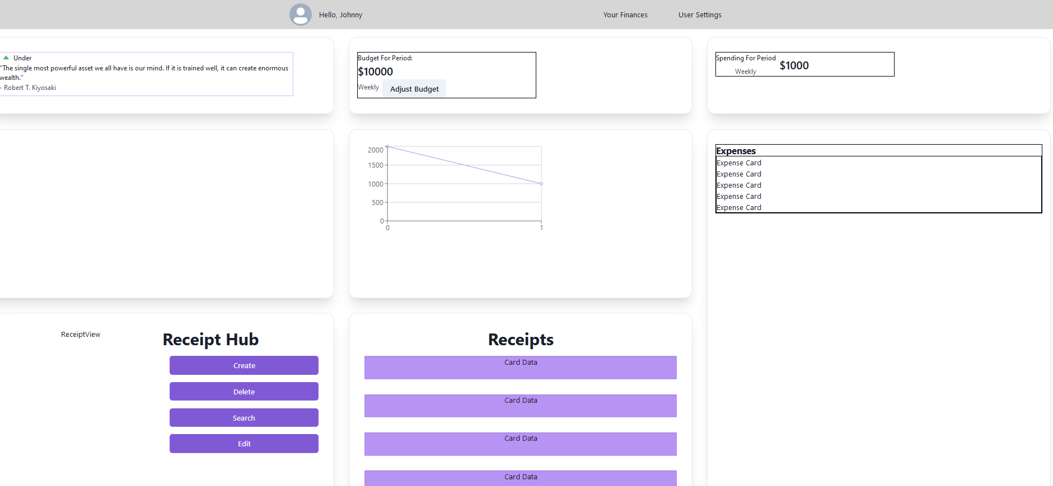
Sneak Peek (10% Down)
Notes:
Speaker - Johnny

Slide 25
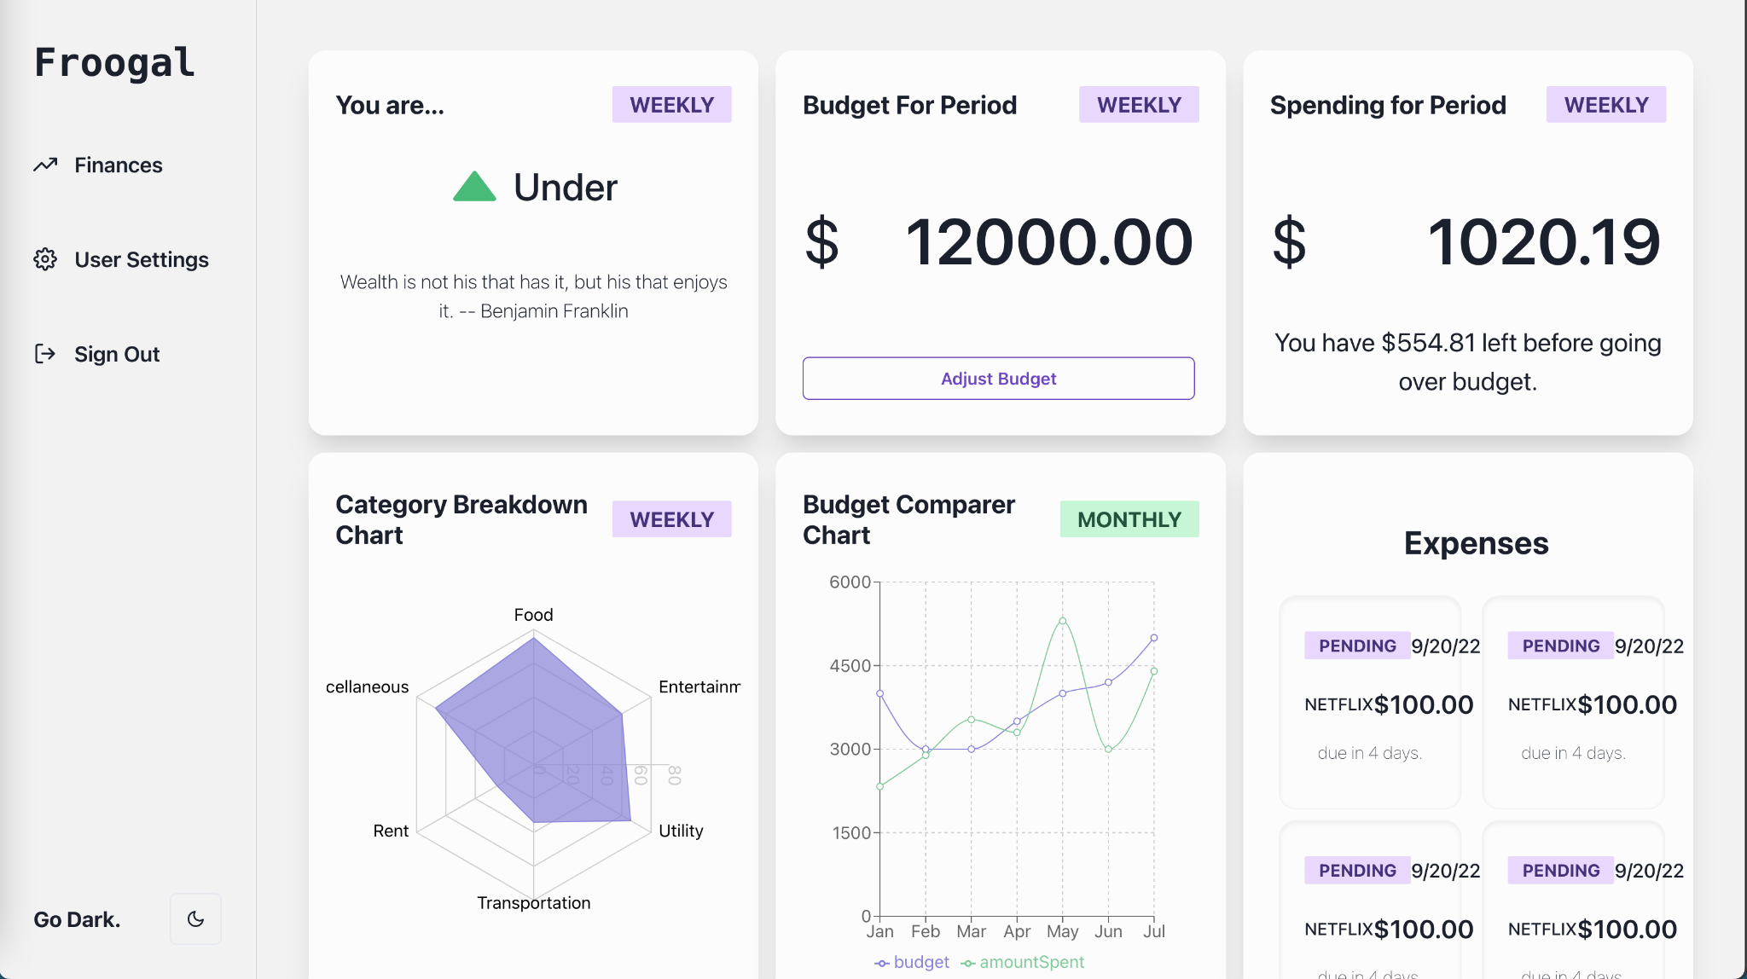
Sneak Peek (20% Down)
Notes:
Speaker - Johnny

Slide 26



The Froogal Team.
Chris Adamson
Dylan Commean
Jonathan Dickson
Product Designer & Developer
Product Designer & Developer
Product Designer & Developer
Notes:
Speaker - Johnny

